Slide 1
Angular Routing
Route Parameters
Lecture 3
By James(Jin) Wang
12/26/2021

Slide 2
Outline
Required Parameters
Configure
Populate
Read
Optional Parameters
Query Parameters

Slide 3
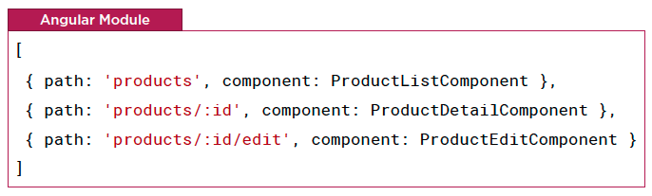
Required Parameters
  Configuring Routes with Placeholders

Slide 4
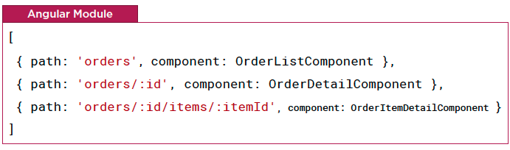
Required Parameters
  Configuring Routes with Placeholders

Slide 5
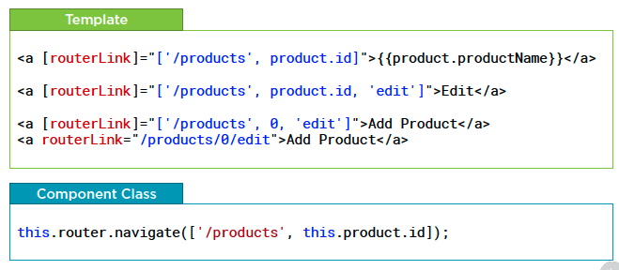
Required Parameters
  Populating Route Parameters

Slide 6
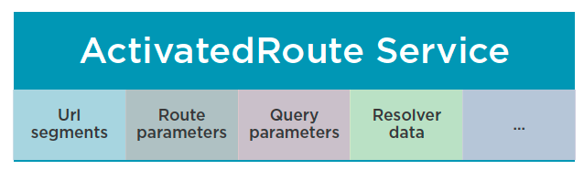
Required Parameters
  Reading Route Parameters

Slide 7
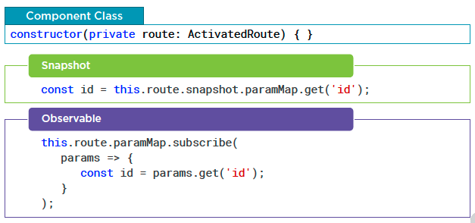
Required Parameters
  Reading Route Parameters

Slide 8
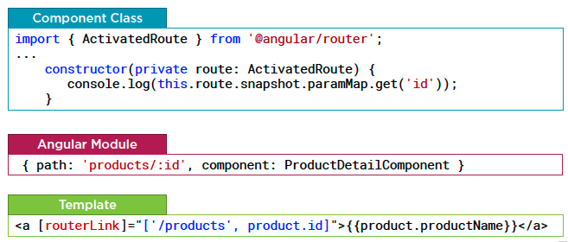
Required Parameters
  Reading Route Parameters: Snapshot
  Demo: read route params: snapshot

Slide 9
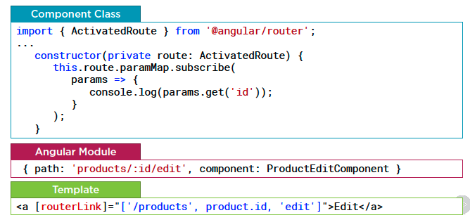
Required Parameters
  Reading Route Parameters: Observable
  Demo: read route params: observable

Slide 10
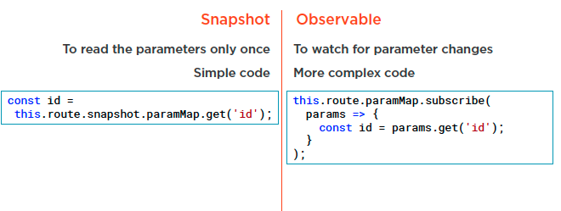
Required Parameters
  Reading Route Parameters

Slide 11
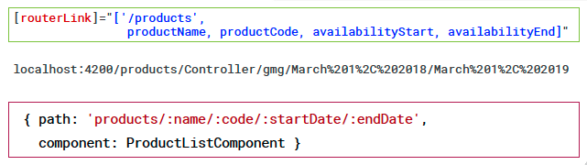
Required Parameters
  With Required Parameters

Slide 12
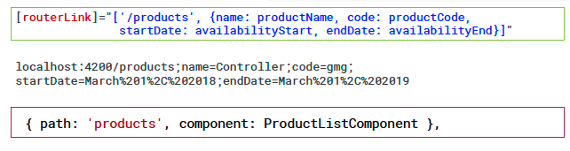
Optional Parameters
  With Optional Parameters

Slide 13
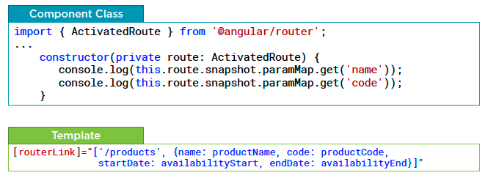
Optional Parameters
  Reading Optional Route Parameters

Slide 14
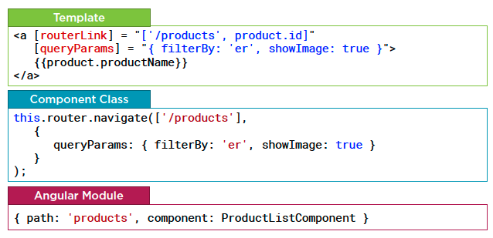
Query Parameters
  Defining Query Parameters

Slide 15
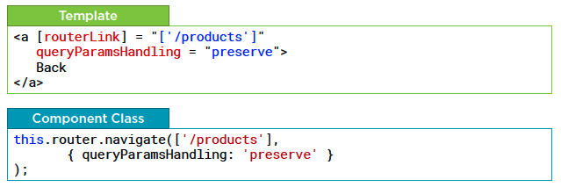
Query Parameters
  Retaining Query Parameters

Slide 16
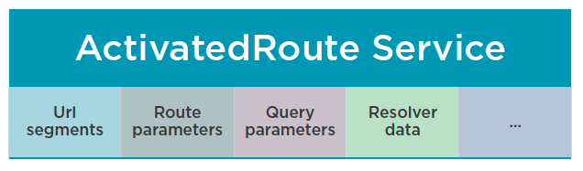
Query Parameters
  Reading Query Parameters

Slide 17
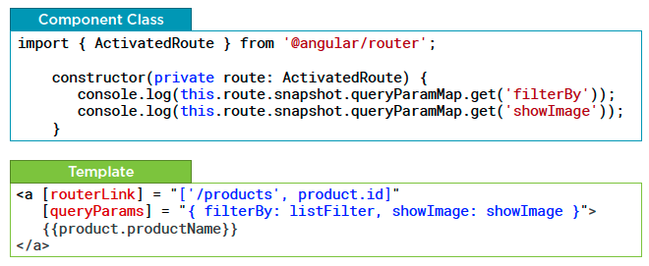
Query Parameters
  Reading Query Parameters
  Demo: query parameter

Slide 18
Summary

Slide 19
Assignment

Slide 20
Self Study
  Angular Routing
  https://app.pluralsight.com/library/courses/angular-routing

